Slide 1
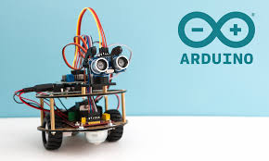

Amethyst Lowe
ME 537
The Crystal Ball Project

Slide 2
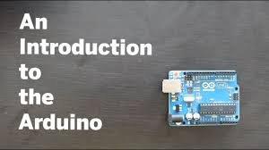
What is Arduino?
Arduino is an open-source platform used for building electronics projects. Arduino consists of both a physical programmable circuit board (often referred to as a microcontroller) and a piece of software, or IDE (Integrated Development Environment) that runs on your computer, used to write and upload computer code to the physical board.
The Arduino platform has become quite popular with people just starting out with electronics, and for good reason. Unlike most previous programmable circuit boards, the Arduino does not need a separate piece of hardware (called a programmer) in order to load new code onto the board -- you can simply use a USB cable. Additionally, the Arduino IDE uses a simplified version of C++, making it easier to learn to program. Finally, Arduino provides a standard form factor that breaks out the functions of the micro-controller into a more accessible package.

Slide 3

Crystal Ball “Fortune Teller”
This project was intended to connect the LCD screen to the arduino setup and based on the code, the screen would produce different outputs. Using the potentiometer to control the clarity of the output, the screen would show whatever message that was written. The setup included many wires to carry electrical energy from the bus line to the actual LCD screen to power up each screen cell. Specifically in this project, an array of strings was used to randomly select an output as the answer to a question that was asked to this “crystal ball.”

Slide 4
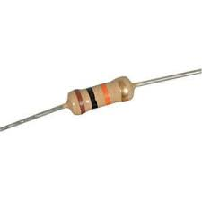
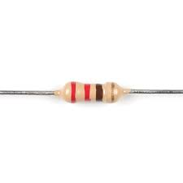
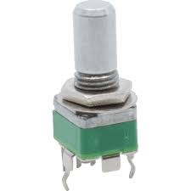
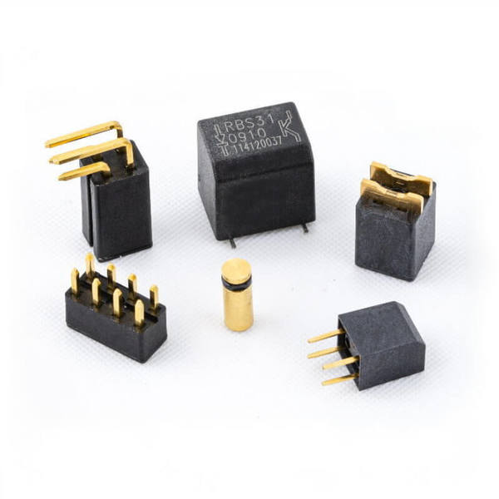
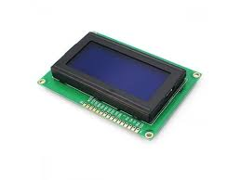
Ingredients
10 KILOHM RESISTOR
220 OHM RESISTOR
POTENTIOMETER
TILT SENSOR
LCD SCREEN

Slide 5
Build The Circuit
Step 1: Pay attention when wiring everything up to make sure it’s correct.
Step 2: Connect power and ground to one side of my breadboard.
Step 3: Place tilt switch on breadboard, attach one lead to SV. Attach other end to ground through 10 kilohm resistor, and Arduino pin 6. Wire as digital input.
Step 4: RS, R/W, EN, DO-D7, D4-D7. You’ll use a potentiometer to control this.
Step 5: LiquidCrystal library handles all writing and simplifies the process of writing software.
Step 6: Connect: Arduino Digital pin 2 to LCD D7, pin 3 to LCD D6, pin 4 to LCD D5, pin 5 to LCD D4. These data pins tell the screen what character to display.
Step 7: Connect EN to pin 11 on your Arduino. RS on LCD connects to pin 12. Enables writing to LCD.
Step 8: Place potentiometer on breadboard, connect one end pin to power, other end to ground. Center pin connects to V0 on the LCD. Allows you to change contrast of the screen.

Slide 6
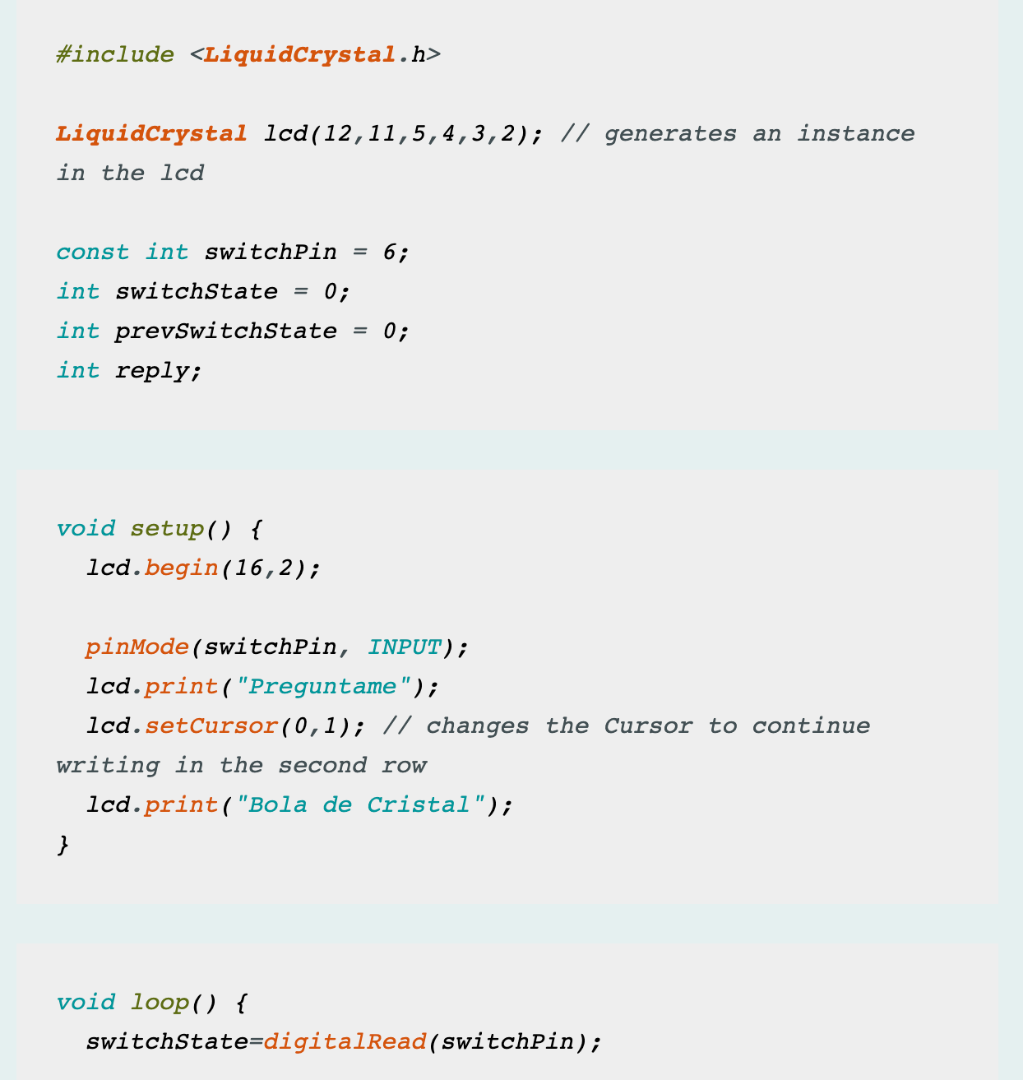
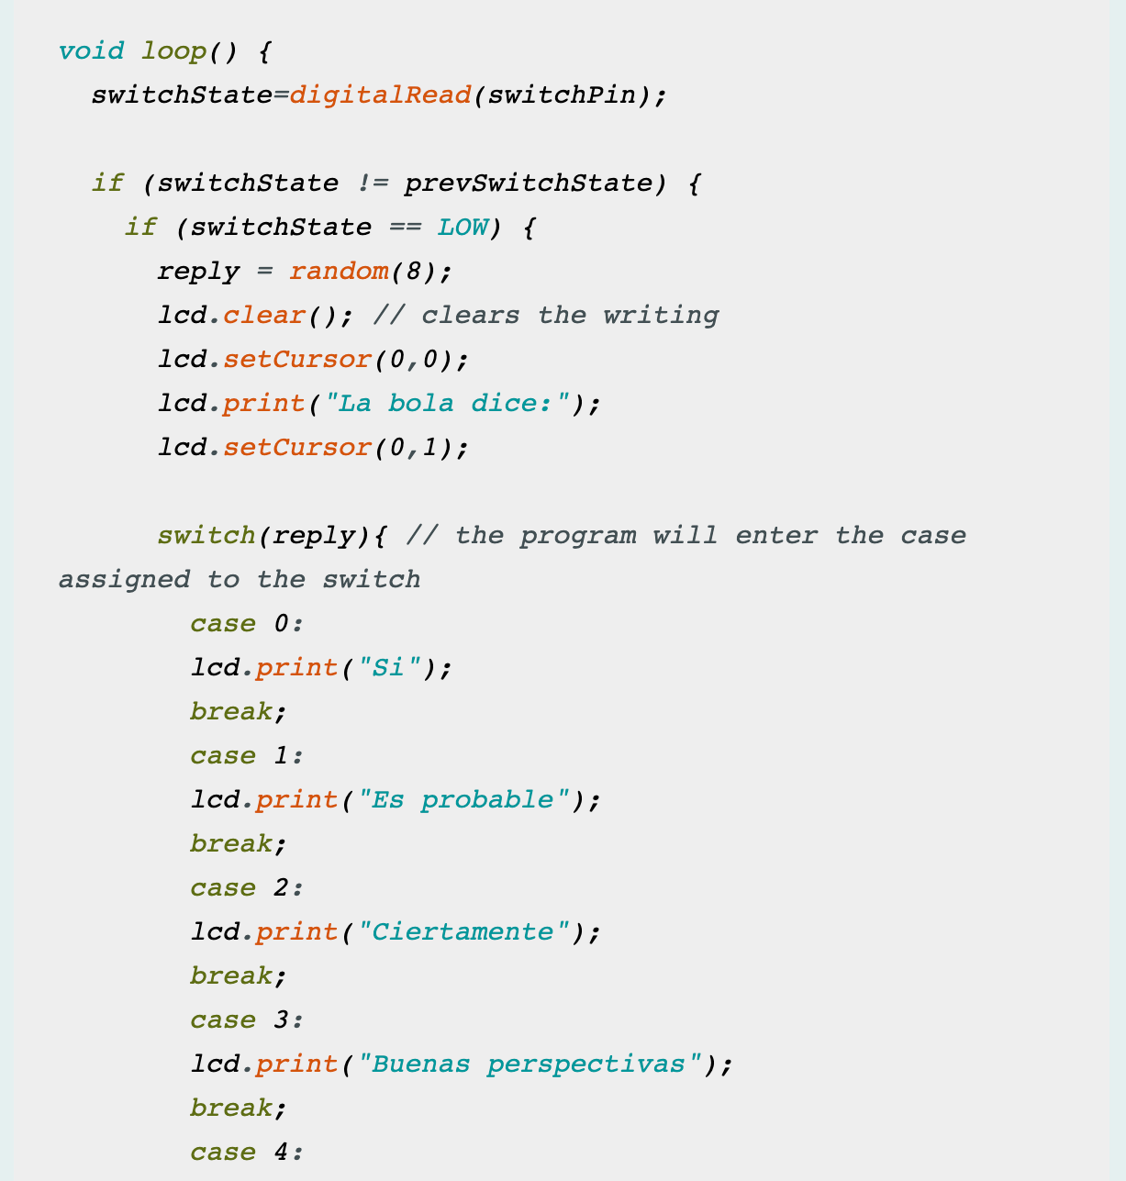
The Code

Slide 7
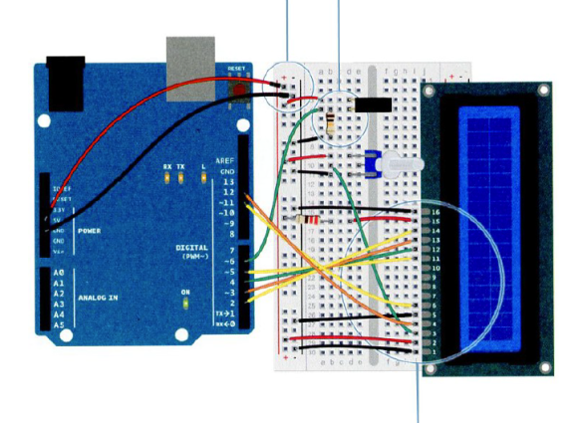
Use It
To use the magic ball, power the Arduino. Check the screen to make sure it says “Ask the Crystal Ball!” If you can’t see the characters, try turning the potentiometer. It will adjust the contrast of the screen. Ask your crystal ball a question and try tilting the switch upside down and back again. An answer to the question should be given. If the answer doesn’t suit you, ask again.
An LCD display enables you to show text on a screen, using the LiquidCrystal library. With a switch… case statements control the flow of programs by comparing a variable to specified values.

Slide 8

Questions?

